Slide 1


Data structure
Fundamental Computer Programming C++
Dr. Ihsan Ullah
ihsan@saturn.yzu.edu.tw
Office: 60913

Slide 2
Introduction to structures in C++
#include <iostream>
using namespace std;
// Define a struct to hold information about a book
struct Book {
string title;
string author;
int year;
};
int main() {
// Create an object of type Book
Book myBook;
// Assign values to the structure members
myBook.title = "C++ Programming";
myBook.author = "Bjarne Stroustrup";
myBook.year = 1985;
// Access and display the members
cout << "Title: " << myBook.title << endl;
cout << "Author: " << myBook.author << endl;
cout << "Year: " << myBook.year << endl;
return 0;
}
A struct is a user-defined data type in C++ used to group different types of data together.
It allows the storage of data members of different types in one entity.
It very similar to class.

Slide 3
Introduction to structures in C++
Pass by Reference
#include <iostream>
using namespace std;
// Define a struct for a rectangle
struct Rectangle {
double length;
double width;
};
// Function to calculate area (pass by reference)
void calculateArea(Rectangle &rect) {
double area = rect.length * rect.width;
cout << "Area of rectangle: " << area << endl;
}
int main() {
// Create an object of type Rectangle
Rectangle rect = {5.0, 3.0};
// Pass structure by reference
calculateArea(rect);
return 0;
}

Slide 4
Structure Vs Class in C++
Default Access Modifier:
struct: Members are public by default.
class: Members are private by default.
Purpose:
struct: Primarily used for simple data grouping (e.g., plain data structures).
class: Used for object-oriented programming (OOP), encapsulating data and behavior.
Inheritance:
struct: Default inheritance is public.
class: Default inheritance is private.
Complexity:
struct: Suitable for lightweight, simple structures without much functionality.
class: Designed for more complex designs with encapsulation, polymorphism, and abstraction.
Flexibility:
Both can have methods, constructors, and access specifiers (public, private, protected), but class is preferred for OOP because of its default private nature and semantic clarity.

Slide 5
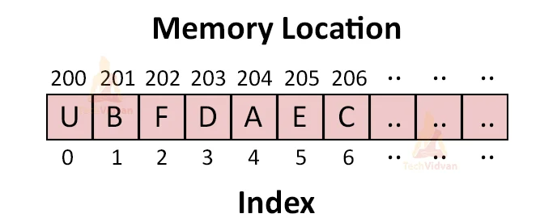
Introduction to Data Structures in C++
What are Data Structures
Data structures are specialized formats for organizing, processing, retrieving, and storing data.
They provide a way to efficiently access and manipulate data.
Different data structures are suited for different types of data and operations.

Slide 6
Introduction to Data Structures in C++
Why Use Data Structures
Data structures improve the efficiency of programs.
They make code more organized and easier to understand.
They allow for reusability of code.
They help to manage memory efficiently.
Reduce the time it takes to access and manipulate data.
Improve the organization of our code, making it easier to read and maintain.
Reuse code that implements common data structures.
Minimize memory usage by avoiding unnecessary data duplication.

Slide 7
Types of Data Structures in C++
There are many different types of data structures in C++.
Some of the most common ones include:
Arrays: A collection of items stored at contiguous memory locations.
Linked lists: A collection of nodes where each node contains data and a reference to the next node in the list.
Stacks: A LIFO (Last In, First Out) data structure.
Queues: A FIFO (First In, First Out) data structure.
Trees: A hierarchical data structure that simulates a tree-like structure.
Graphs: A collection of nodes connected by edges.

Slide 8
Arrays in C++
An array is a collection of elements of the same data type stored in contiguous memory locations.
Allows storing multiple values in a single variable.
Each element can be accessed using an index.
data_type array_name[array_size];
int numbers[5]; // Declares an array of 5 integers

Slide 9
Arrays in C++
#include <iostream>
using namespace std;
int main() {
int numbers[5] = {1, 2, 3, 4, 5};
cout << "Array elements:" << endl;
for(int i = 0; i < 5; i++) {
cout << "Element at index " << i << ": " << numbers[i] << endl;
}
return 0;
}

Slide 10
Multidimensional Arrays
int element = matrix[3][3];
// Accesses the element at second row, third column (value 6)
int matrix[3][3] = {
{1, 2, 3},
{4, 5, 6},
{7, 8, 9}
};

Slide 11
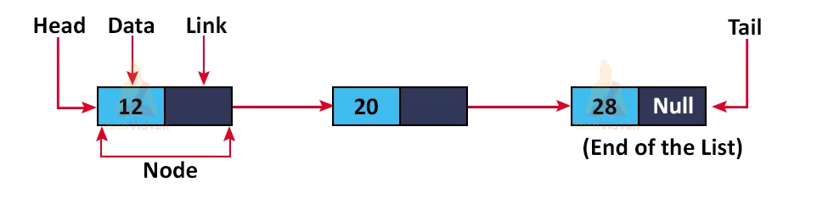
Linked Lists in C++
A data structure consisting of nodes where each node contains data and a pointer to the next node.
Allows for efficient insertion and deletion of elements.
Dynamic size
Elements (nodes) are not stored at contiguous memory locations
Each node points to the next node

Slide 12
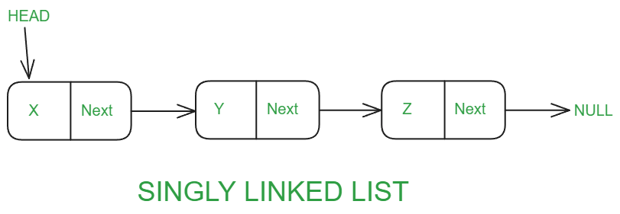
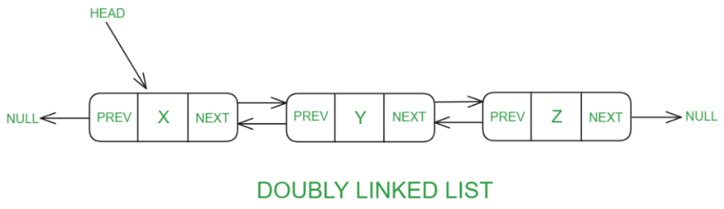
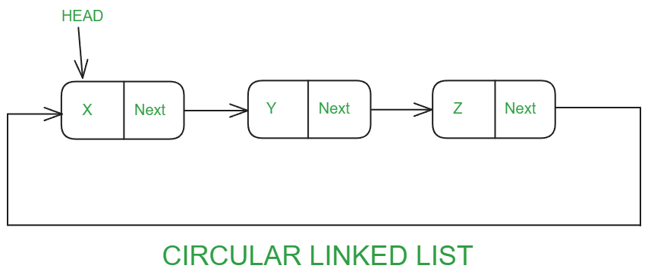
Types of Linked Lists
Singly Linked List:
Each node points to the next node
Last node points to nullptr
Doubly Linked List:
Each node points to both the next and previous nodes
Allows traversal in both directions
Circular Linked List:
Last node points back to the first node
Can be singly or doubly linked

Slide 13
Linked List:
Example: Creating a Singly Linked List
#include <iostream>
using namespace std;
struct Node {
int data;
Node* next;
};
int main() {
Node* head = new Node();
Node* second = new Node();
Node* third = new Node();
head->data = 1; // Assign data to first node
head->next = second; // Link first node to second node
second->data = 2; // Assign data to second node
second->next = third; // Link second node to third node
third->data = 3; // Assign data to third node
third->next = nullptr; // End of the list
return 0;
}

Slide 14
Stacks in C++
A stack is a linear data structure that follows the Last In, First Out (LIFO) principle.
Elements are added (pushed) and removed (popped) from the top of the stack.
LIFO (Last In, First Out)
Basic operations: push, pop, top, isEmpty
Used in various applications like expression evaluation, syntax parsing, and function call management

Slide 15
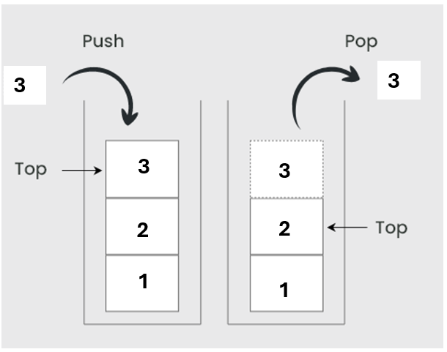
Stacks in C++
#include <stack>
#include <iostream>
using namespace std;
int main() {
stack<int> s;
s.push(1); // Stack: [1]
s.push(2); // Stack: [1, 2]
s.push(3); // Stack: [1, 2, 3]
cout << "Top element: " << s.top() << endl; // Output: 3
s.pop(); // Stack: [1, 2]
cout << "Top element after pop: " << s.top() << endl; // Output: 2
return 0;
}

Slide 16
Queues in C++
A queue is a linear data structure that follows the First In, First Out (FIFO) principle.
Elements are added (enqueued) at the back and removed (dequeued) from the front.
FIFO (First In, First Out)
Basic operations: enqueue, dequeue, front, rear, isEmpty
Used in various applications like scheduling, buffering, and breadth-first search.

Slide 17
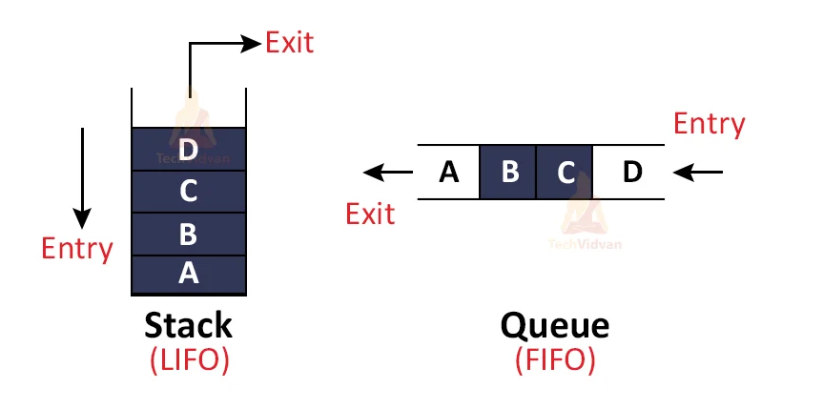
Queues in C++

Slide 18
Queues in C++
#include <queue>
#include <iostream>
using namespace std;
int main() {
queue<int> q;
q.push(1); // Enqueue: [1]
q.push(2); // Enqueue: [1, 2]
q.push(3); // Enqueue: [1, 2, 3]
cout << "Front element: " << q.front() << endl; // Output: 1
q.pop(); // Dequeue: [2, 3]
cout << "Front element after dequeue: " << q.front() << endl; // Output: 2
return 0;
}

